Slide 1

Data Science Project

Slide 2
CONTENTS
ABSTRACT
INTRODUCTION
PROBLEM STATEMENT
DESCRIPTION OF DATA
APPROACH
PROGRAM CODE
OUTPUT
CONCLUSION

Slide 3
ABSTRACT
The real fact in the education institute is the significant growth of education data.
The main goal of this presentation is to look at the various aspects that affect the test scores of students in various educational institutions.
Data mining techniques was used to extract the essential information from the data set and to explore the relationships between variable stored in the data sets.

Slide 4
INTRODUCTION
The data in various educational institutes is growing significantly. Presently the need to represent data in an integrated and consistent format is also increasing.
So we propose a model on which data mining and data warehouse techniques can be applied to predict student academic performance in schools.
Data mining is a technique to find a relationship between variables or factors in the large amount of database (usually data warehouse).
The data and information gained from the learning system can be used as an substantial indicator for monitoring of the potential student failure in the school.
Furthermore alerts can be sent to the parent and academic staff to intimate them about the performance of the student.

Slide 5
PROBLEM STATEMENT
Student performance was measured based on maths, reading and writing score. What are the major factors influencing the test scores? How do you measure the effectiveness of a test preparation course?

Slide 6
DESCRIPTION OF DATA
The data given to us are of a set of students of educational institutions where we need to find out which factors influence the test score of the students based on different features such as Race/ethnicity, Parental educational background , Lunch type, Test preparation which influence their Math scores, Reading scores, and Writing scores.

Slide 7
APPROACH
We opened the data given in CSV format through MS Excel and made a separate column named “Average Scores” and stored the average of math score, reading score, writing score there for every student irrespective of any feature.
Next we segregated every data feature wise with average score for example gender with average score, race with average score, etc.
We grouped every feature’s average score. For example we grouped the average score for parental educational background with Bachelor’s Degree.
We are plotting the groups with two axis X and Y. In X axis we are keeping all the independent data like test preparation completed or not, gender, race, lunch type and in Y axis we are keeping all the dependent data , i.e. we re keeping the average score and plotting bar graphs for all the features, and finally showing up how the graph is coming.

Slide 8

PROGRAM CODE

Slide 9
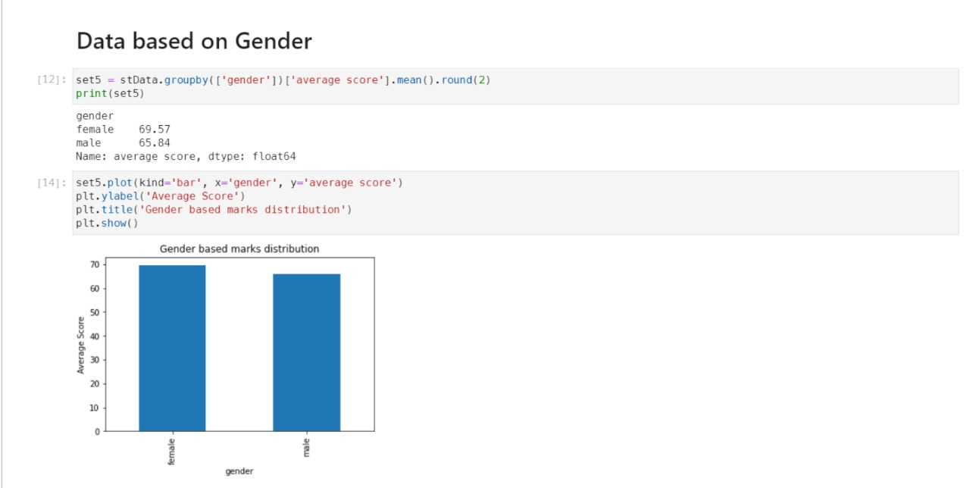
OUTPUT

Slide 10
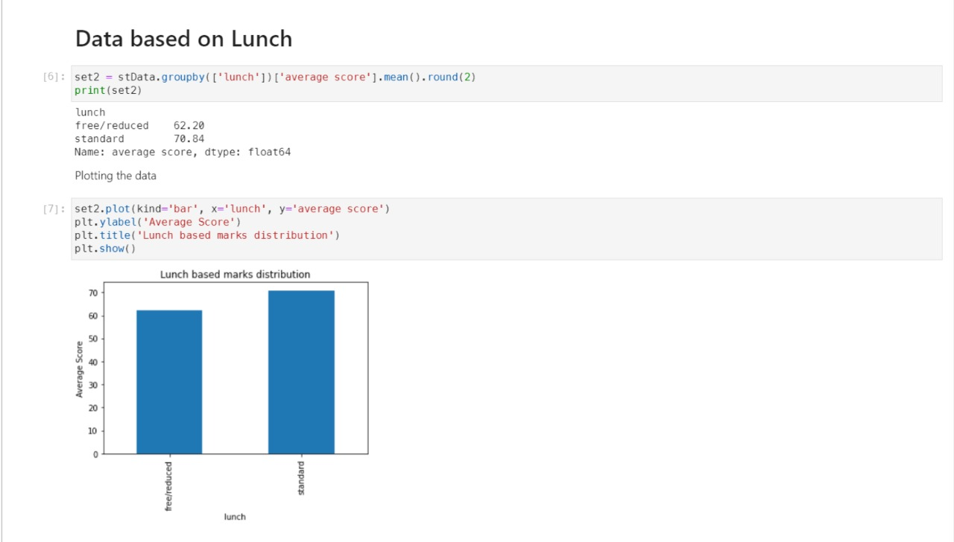
OUTPUT

Slide 11
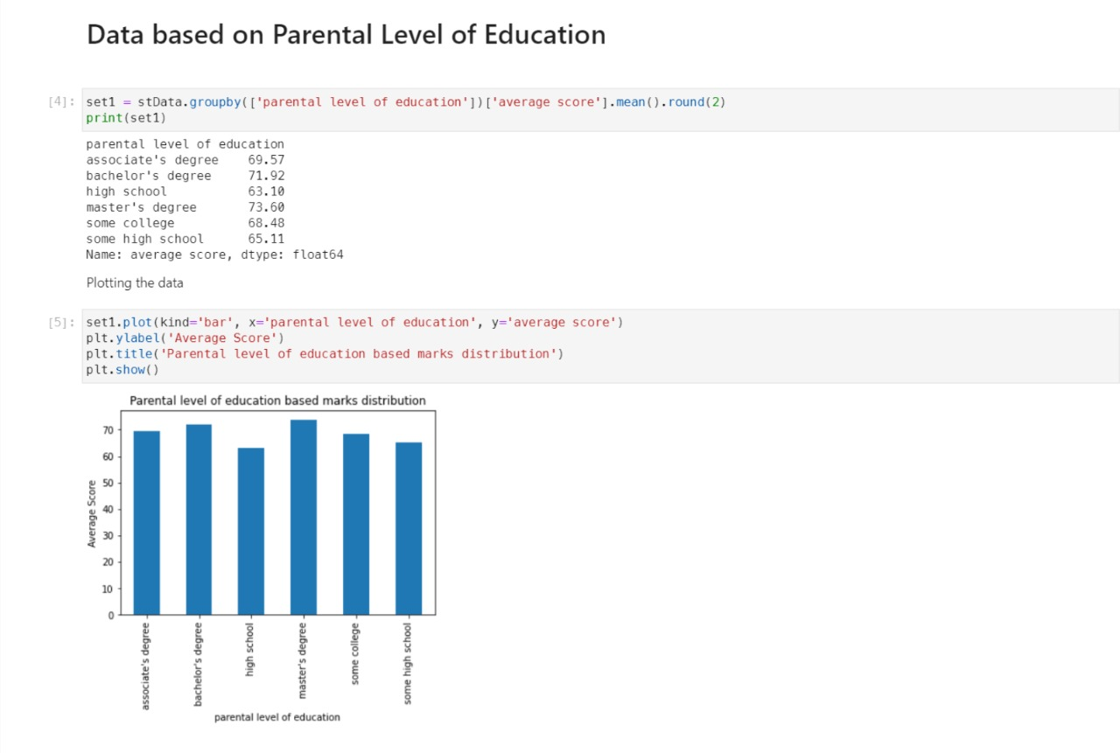
OUTPUT

Slide 12
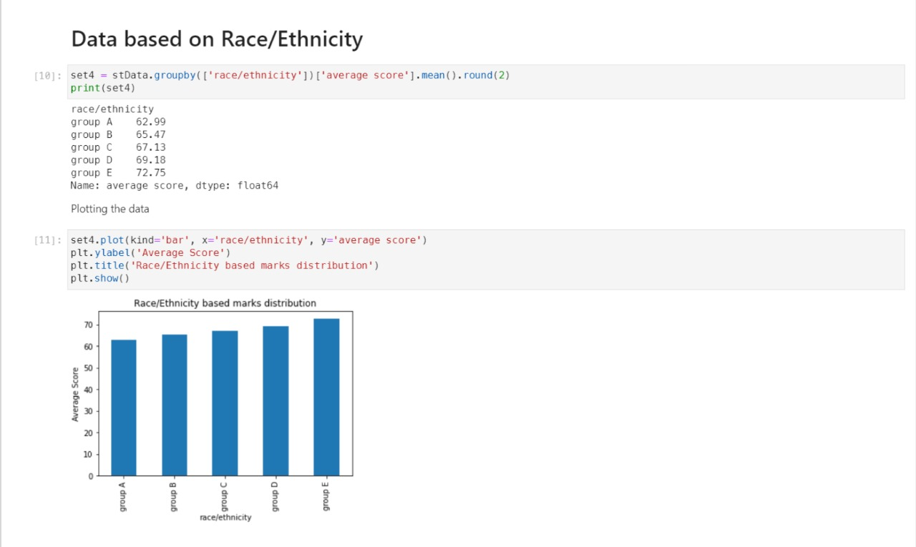
OUTPUT

Slide 13
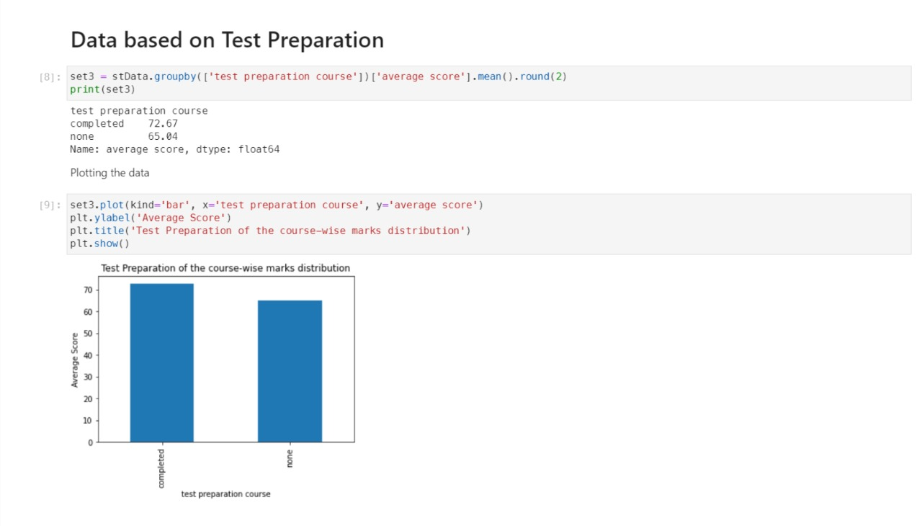
OUTPUT

Slide 14
CONCLUSION
Major factors influencing the test scores are:
1. Lunch provided 2. Parental Level of Education 3. Test Preparation.
Out of these, the Parental Level of Education cannot be changed by the educational institution as it is already fixed by the students. However, if the educational institution looks into the lunch provided and the test preparation of the students, the scores would drastically improve.
To measure the effectiveness of a test preparation course, we can see the average scores scored by the students who have taken the preparation course and those students who have not taken the preparation course and infer from the comparison data

Slide 15
INDIVIDUAL CONTRIBUTIONS
Rishiraj Chakraborty - 18701617070 – PowerPoint Presentation
Debanjan Paul – 18701617119 - Code and Output graphs
Anirban Dandapat – 18701618013 -Presenter
Dhrubajyoti Chatterjee – 18701617116 – Presenter
Rahul Rooj - 18701617078 - Presenter

Slide 16
THANK YOU

